Slide 1


Technical Design Thinking I
Fall 2025
Software Structures / Programming
Dr. Bruce McFall

Slide 2

Software Building Blocks

Slide 3

Three Main Software Structures

Slide 4
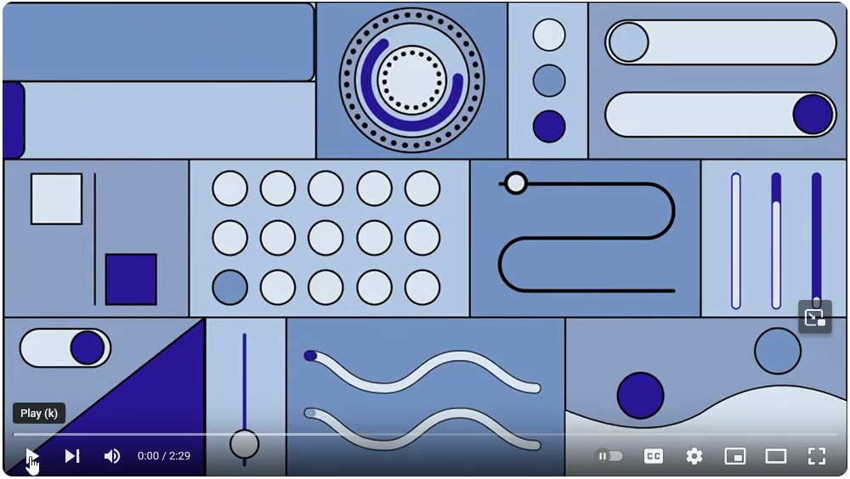
Algorithms

Slide 5

Binary

Slide 6

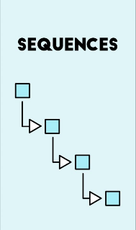
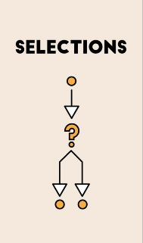
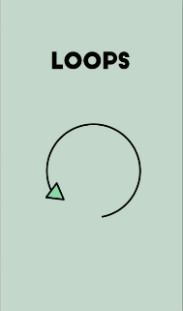
Programming Languages
Once the fundamental language structures that connect to the basic software/hardware level are described and understood, using a different programming language to solve a problem can/will basically involve a change of syntax

Slide 7
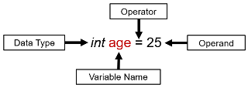
Data Structures – Variable Declaration
Variable Declaration is an important step which allows the correct identification of the bits that are used for the variable (int age, identifies how many bits are defined for the variable age). The identifier for each Data Type can change based on the syntax of a programming language, but are for the most part very similar. Note the different patterns of bits used for different data types shown below (it's not important for you to know the details, the identifier takes care of that for you)
Correctly typed variables are important because many difficult to find errors are caused by not taking enough care when deciding what the type should be. Compiled Languages often require you to specifically type each variable, where Interpreted Languages often figure out the types automatically "on the fly" which can result in unforeseen errors that are difficult to debug

Slide 8
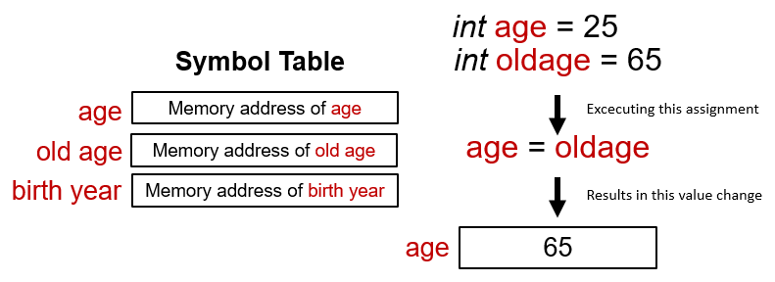
Data Structures – Variable Declaration
As was shown in the initial diagram of variable declaration, two other exceptionally important items are part of the combined variable declaration/assignment statement
Operands and Operators are the fundamental glue that integrates all arithmetic and logical methods together in almost any programming language and will be included in most of the following descriptions of language fundamentals
Operators perform various operations on Operands. In this case, the Assignment Operator (=), is used to copy a constant, literal, variable expression result, or function result to a variable

Slide 9
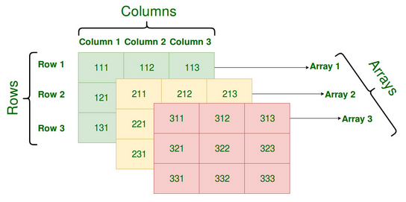
Data Structures – Array / Matrix
Using similar steps for Defining and Data Typing, the setup of an Array / Matrix is straightforward with some slight differences, and can change based on language syntax
To Define the example 3D arrays shown above, use the same statement - but with some basic changes. This is a general Definition and Data Typing version: int Array(3,3,3). The statement to initialize it at the same time is a bit more complex. One notation to access an element of the 3D array is based on Array_Name(array number, row number, column number), so to access the top left element of the yellow array you would use Array_Name(2,1,1), likewise the center of the pink array would be accessed using Array_Name(3,2,2).

Slide 10
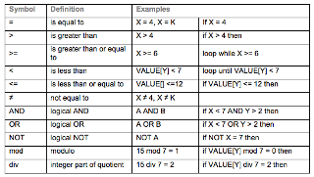
Operators – Arithmetic / Logical
Operators for each language are often very similar, so check the syntax guide closely for each of the fundamental language structures shown above and use versions shown there to keep from using incorrect versions

Slide 11
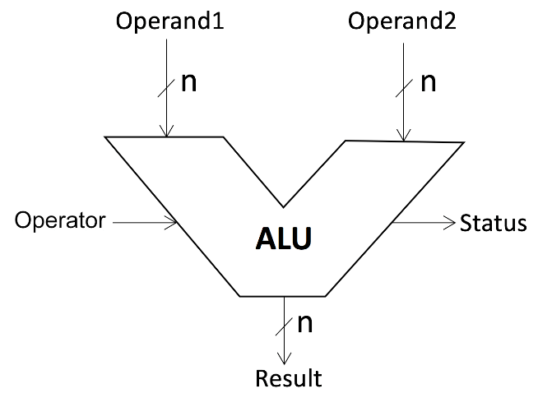
Arithmetic Operations
The setup of Arithmetic Operations uses 2 Operands and 1 Operator - using values that are specific to commands necessary to do basic math such as (+ - x / ^)
As always check with the syntax guide for the language that you are using for your project

Slide 12
Logical Operations
The setup of Logical Operations uses 2 Operands and 1 Operator - using values that are specific to commands necessary to do basic comparisons (> < >= <= ) as well as other more complex operations
As always check with the syntax guide for the language that you are using for your project

Slide 13
Iteration / Repetition Operations
Iteration is based on completing a piece of code a number of times, typically using a "for" loop, starting at a certain number and then counting up/down by a certain step size until the loop is completed based on the conditions given for the loop. Repetition is a more general loop, typically using a "while" loop with assorted syntax types which have various possible conditions possible and can be set up to execute until the conditions are "true" or "false"

Slide 14
Encapsulation
Use generic Input and Output values to provide a generic wrapper around specific algorithms, code sequences, etc. to help with reuse and overall uncluttered program structure (functions, subroutines, external libraries, and other language specific named components)

Slide 15
General Language Structures
Data Structures: Create and use structures to define, access, and change various types of data, (variables, arrays, matrices, vectors, etc.) using the binary computer memory
Arithmetic: Perform basic operations using various arithmetic operators (addition, subtraction, multiplication, and division)
Logical: Make decisions about certain conditions using various logical operators, then follow the proper path (and execute) the matching sequence of commands
Repetition/Iteration: Perform some action repeatedly or via iteration, based on certain conditions and within various loop structures
Encapsulation: Use generic Input and Output values to provide a generic wrapper around specific algorithms, code sequences, etc. to help with reuse and overall uncluttered program structure (functions, subroutines, external libraries, and other language specific named components)
Input: Read/Get data from devices external to the computer (keyboards, USB Drive, etc.)
Output: Write/Send data to devices external to the computer (a display, a file, or other devices)

